Slide 1
Group 1
Ruben Holthuijsen (1064459)
Sander van Swieten (1063788)
Vince van Doorn (1061669)
Victor de Sousa Gama (0929470)
Kevin Hartman (1044032)
TYPOGRAPH TEST
Group 1
Ruben Holthuijsen (1064459)
Sander van Swieten (1063788)
Vince van Doorn (1061669)
Victor de Sousa Gama (0929470)
Kevin Hartman (1044032)
Group 1
Ruben Holthuijsen (1064459)
Sander van Swieten (1063788)
Vince van Doorn (1061669)
Victor de Sousa Gama (0929470)
Kevin Hartman (1044032)
Group 1
Ruben Holthuijsen (1064459)
Sander van Swieten (1063788)
Vince van Doorn (1061669)
Victor de Sousa Gama (0929470)
Kevin Hartman (1044032)
Group 1
Ruben Holthuijsen (1064459)
Sander van Swieten (1063788)
Vince van Doorn (1061669)
Victor de Sousa Gama (0929470)
Kevin Hartman (1044032)

Slide 2
COLOR PALETTE
#80B4B5
#61A6A2
#E1B7B1
#C87777
#7267A2
#575295
#9AB6DA
#6985BF
#A7C374
#8EAE54

Slide 3
Intentionally left blank

Slide 4
RNA sequencing-based Machine Learning for Detection of
Triple Negative Breast Cancer
Ruben Holthuijsen (1064459) • Sander van Swieten (1063788) • Vince van Doorn (1061669)
Victor de Sousa Gama (0929470) • Kevin Hartman (1044032)

Slide 5
Outline
TODO - Opleuken met icoontjes
Context
Approach
Results
Discussion

Slide 6

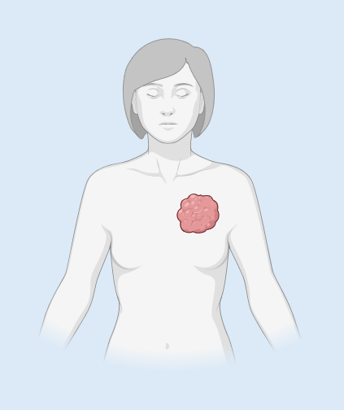



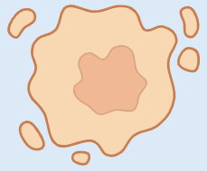

Context
2.300.000 cases of breast cancer worldwide in 2022
TNBC - Overview
Women younger than 40 years of age are highest risk
Triple-Negative Breast Cancer
~10-20% of breast cancer
Triple-Negative Breast Cancer (TNBC)
Breast Cancer
(BC)
ER (ESR1)
/
PGR (PGR)
/
HER2 (ERBB2)
/

Slide 7
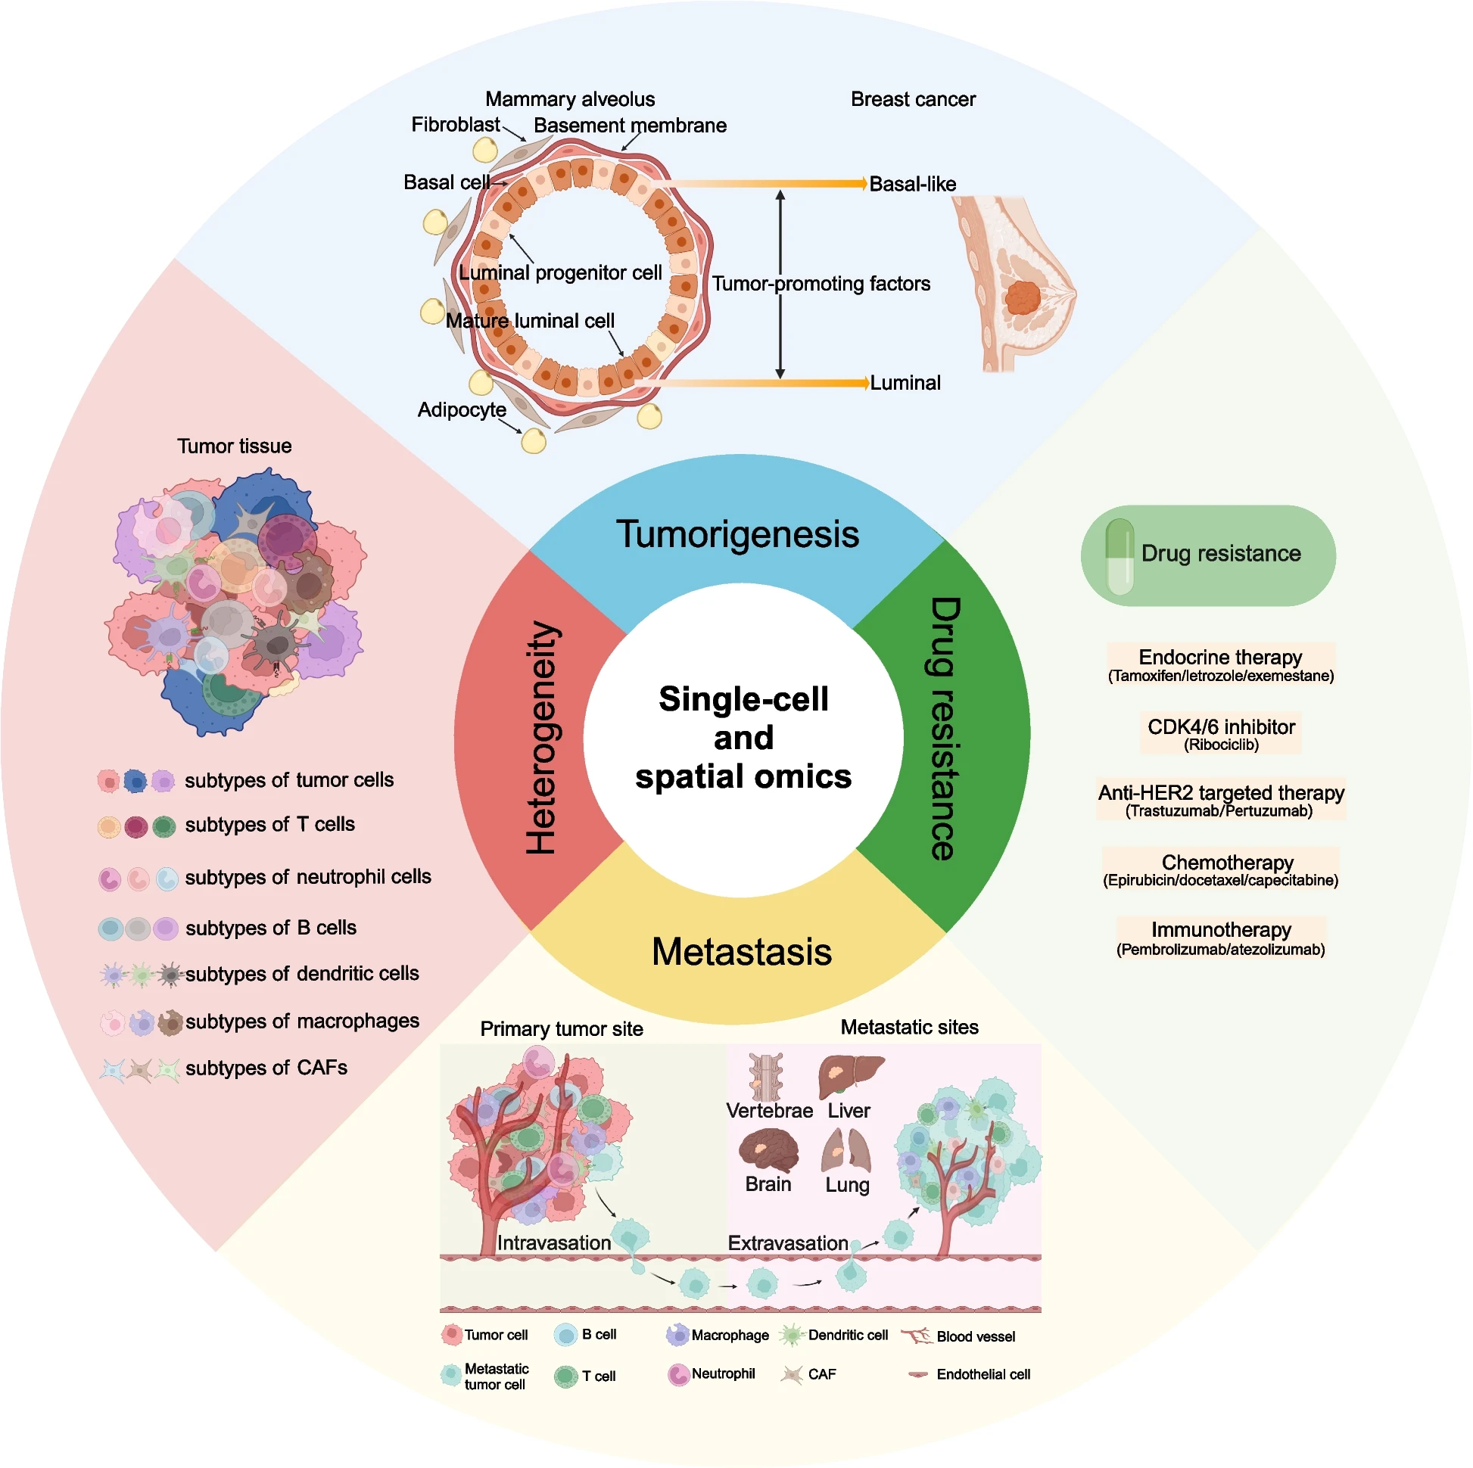
Context
TNBC - Overview
Source:
Xiong et al. Biomarker Research (2024) 12:107
doi 10.1186/s40364-024-00654-1

Slide 8
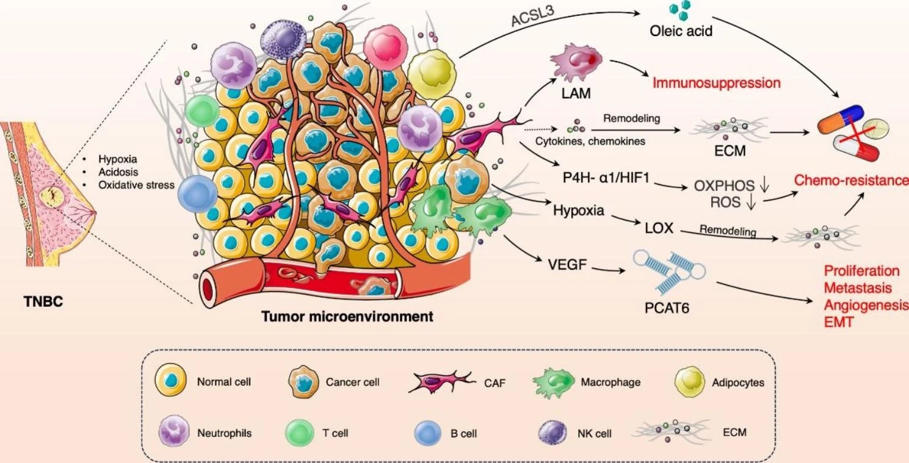
Context
TNBC – Tumor Microenvironment (TME)
Source:
Liu et al. Molecular Cancer (2023) 22:145
doi 10.1186/s12943-023-01850-7

Slide 9
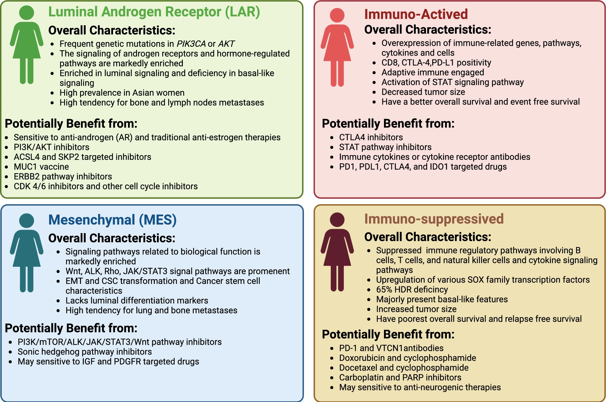
Context
TNBC – Subtyping
Source:
Chen et al. Cell & Bioscience (2025) 15:13
doi 10.1186/s13578-025-01359-0

Slide 10
Approach
Project
TCGA-BRCA
GSE65216
GSE76250
Outlier removal
Imputation
Mean removal
Standardization
Deduplication
Literature
Two methods:
Result 1 article
Review 65 articles
Machine learning
(with SMOTE)
Five methods:
PCA
BORUTA
LASSO
RFE
Statistical
Logistical regression Support Vector Machine
Random Forest
Classification
TNBC / nTNBC
Data loading
Preprocessing
Feature
selection
Model
Output

Slide 11
Approach
RNA expression data of TNBC patients
Data loading
Train/Test
Validation
TCGA-BRCA n = 1097
GEO n = 264
GSE65216, GSE76250
Label based on clinical data
Label based on metadata case
Drop indeterminable cases
Drop cases without RNA data
Tumor samples:
Breast cancer (BC)
Triple-Negative Breast Cancer (TNBC)

Slide 12
Approach
Preprocessing
Missing data
Dimensionality
Harmonization
Imputation
One fifth of the minimum value recorded
KNN
Selection
Quantified in all datasets
Deletion
With near-zero variance
Recursive feature elimination
Principal Component Analysis
Outlier removal
Applying logarithm transformation
Scaling
Standardization
Deduplication
Rows (cases)
Columns (genes)

Slide 13
Approach
Feature selection
Literature
Machine learning
Result 1 article
Feature extraction: PCA
60660 features (all)
65 research papers
oncogenes and biomarkers
Feature selection: BORUTA (Random Forest)
284 features
(research papers)
Feature selection: LASSO (Regression)
SMOTE
Feature selection: RFE (Support Vector Machine)
Statistical methods
19962 features (protein)

Slide 14
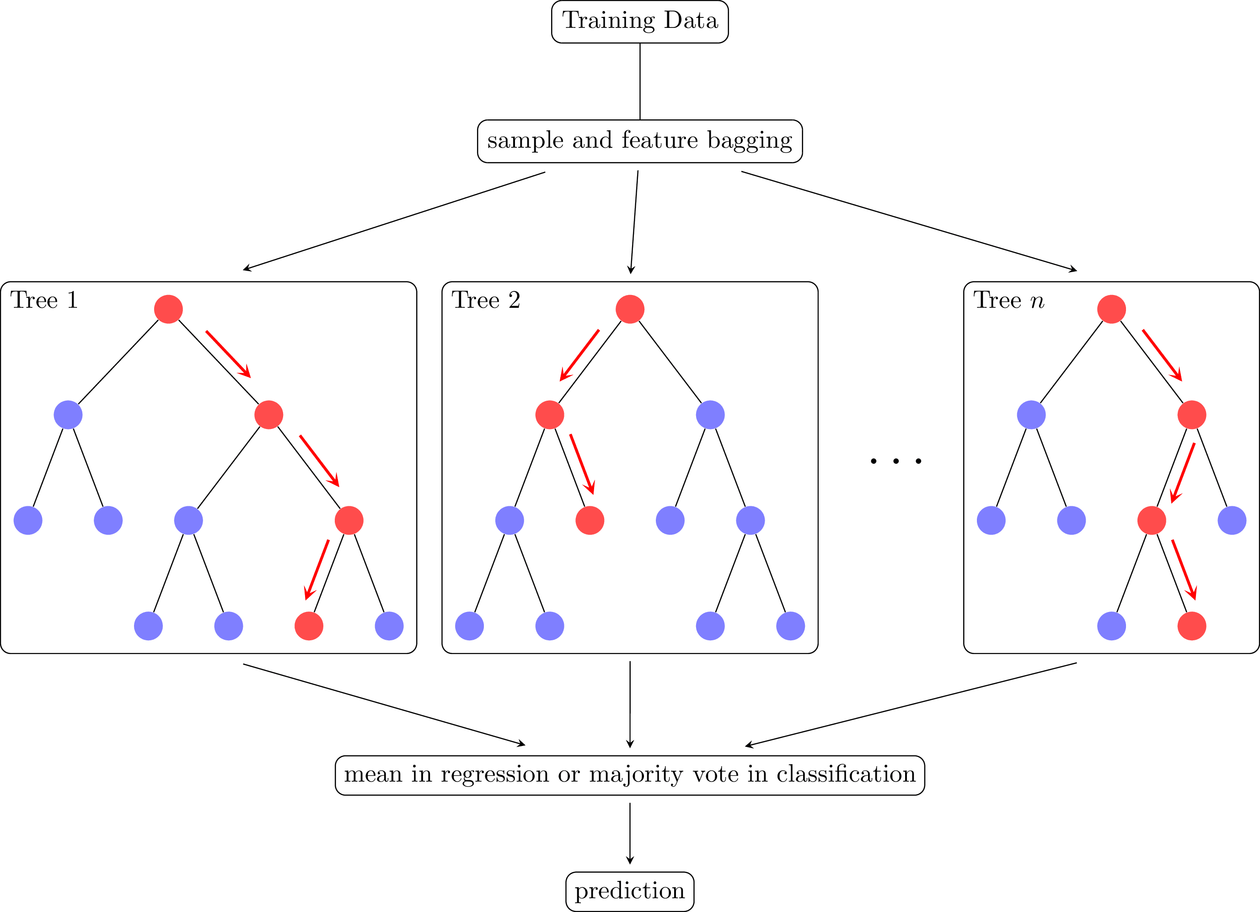
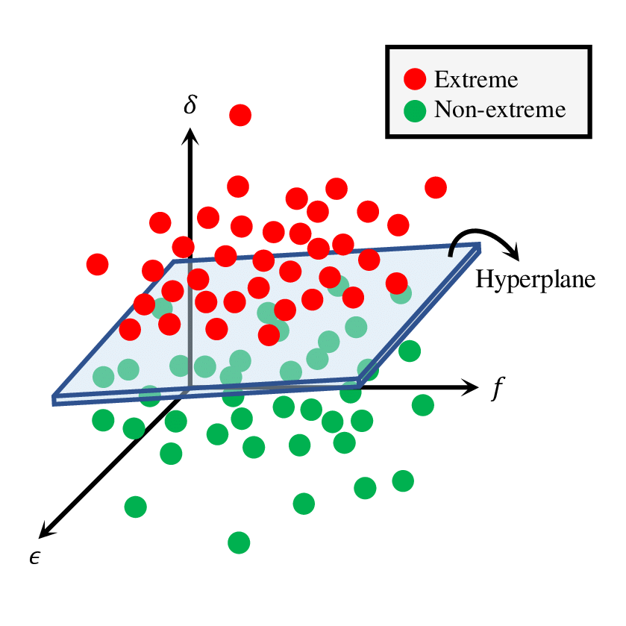
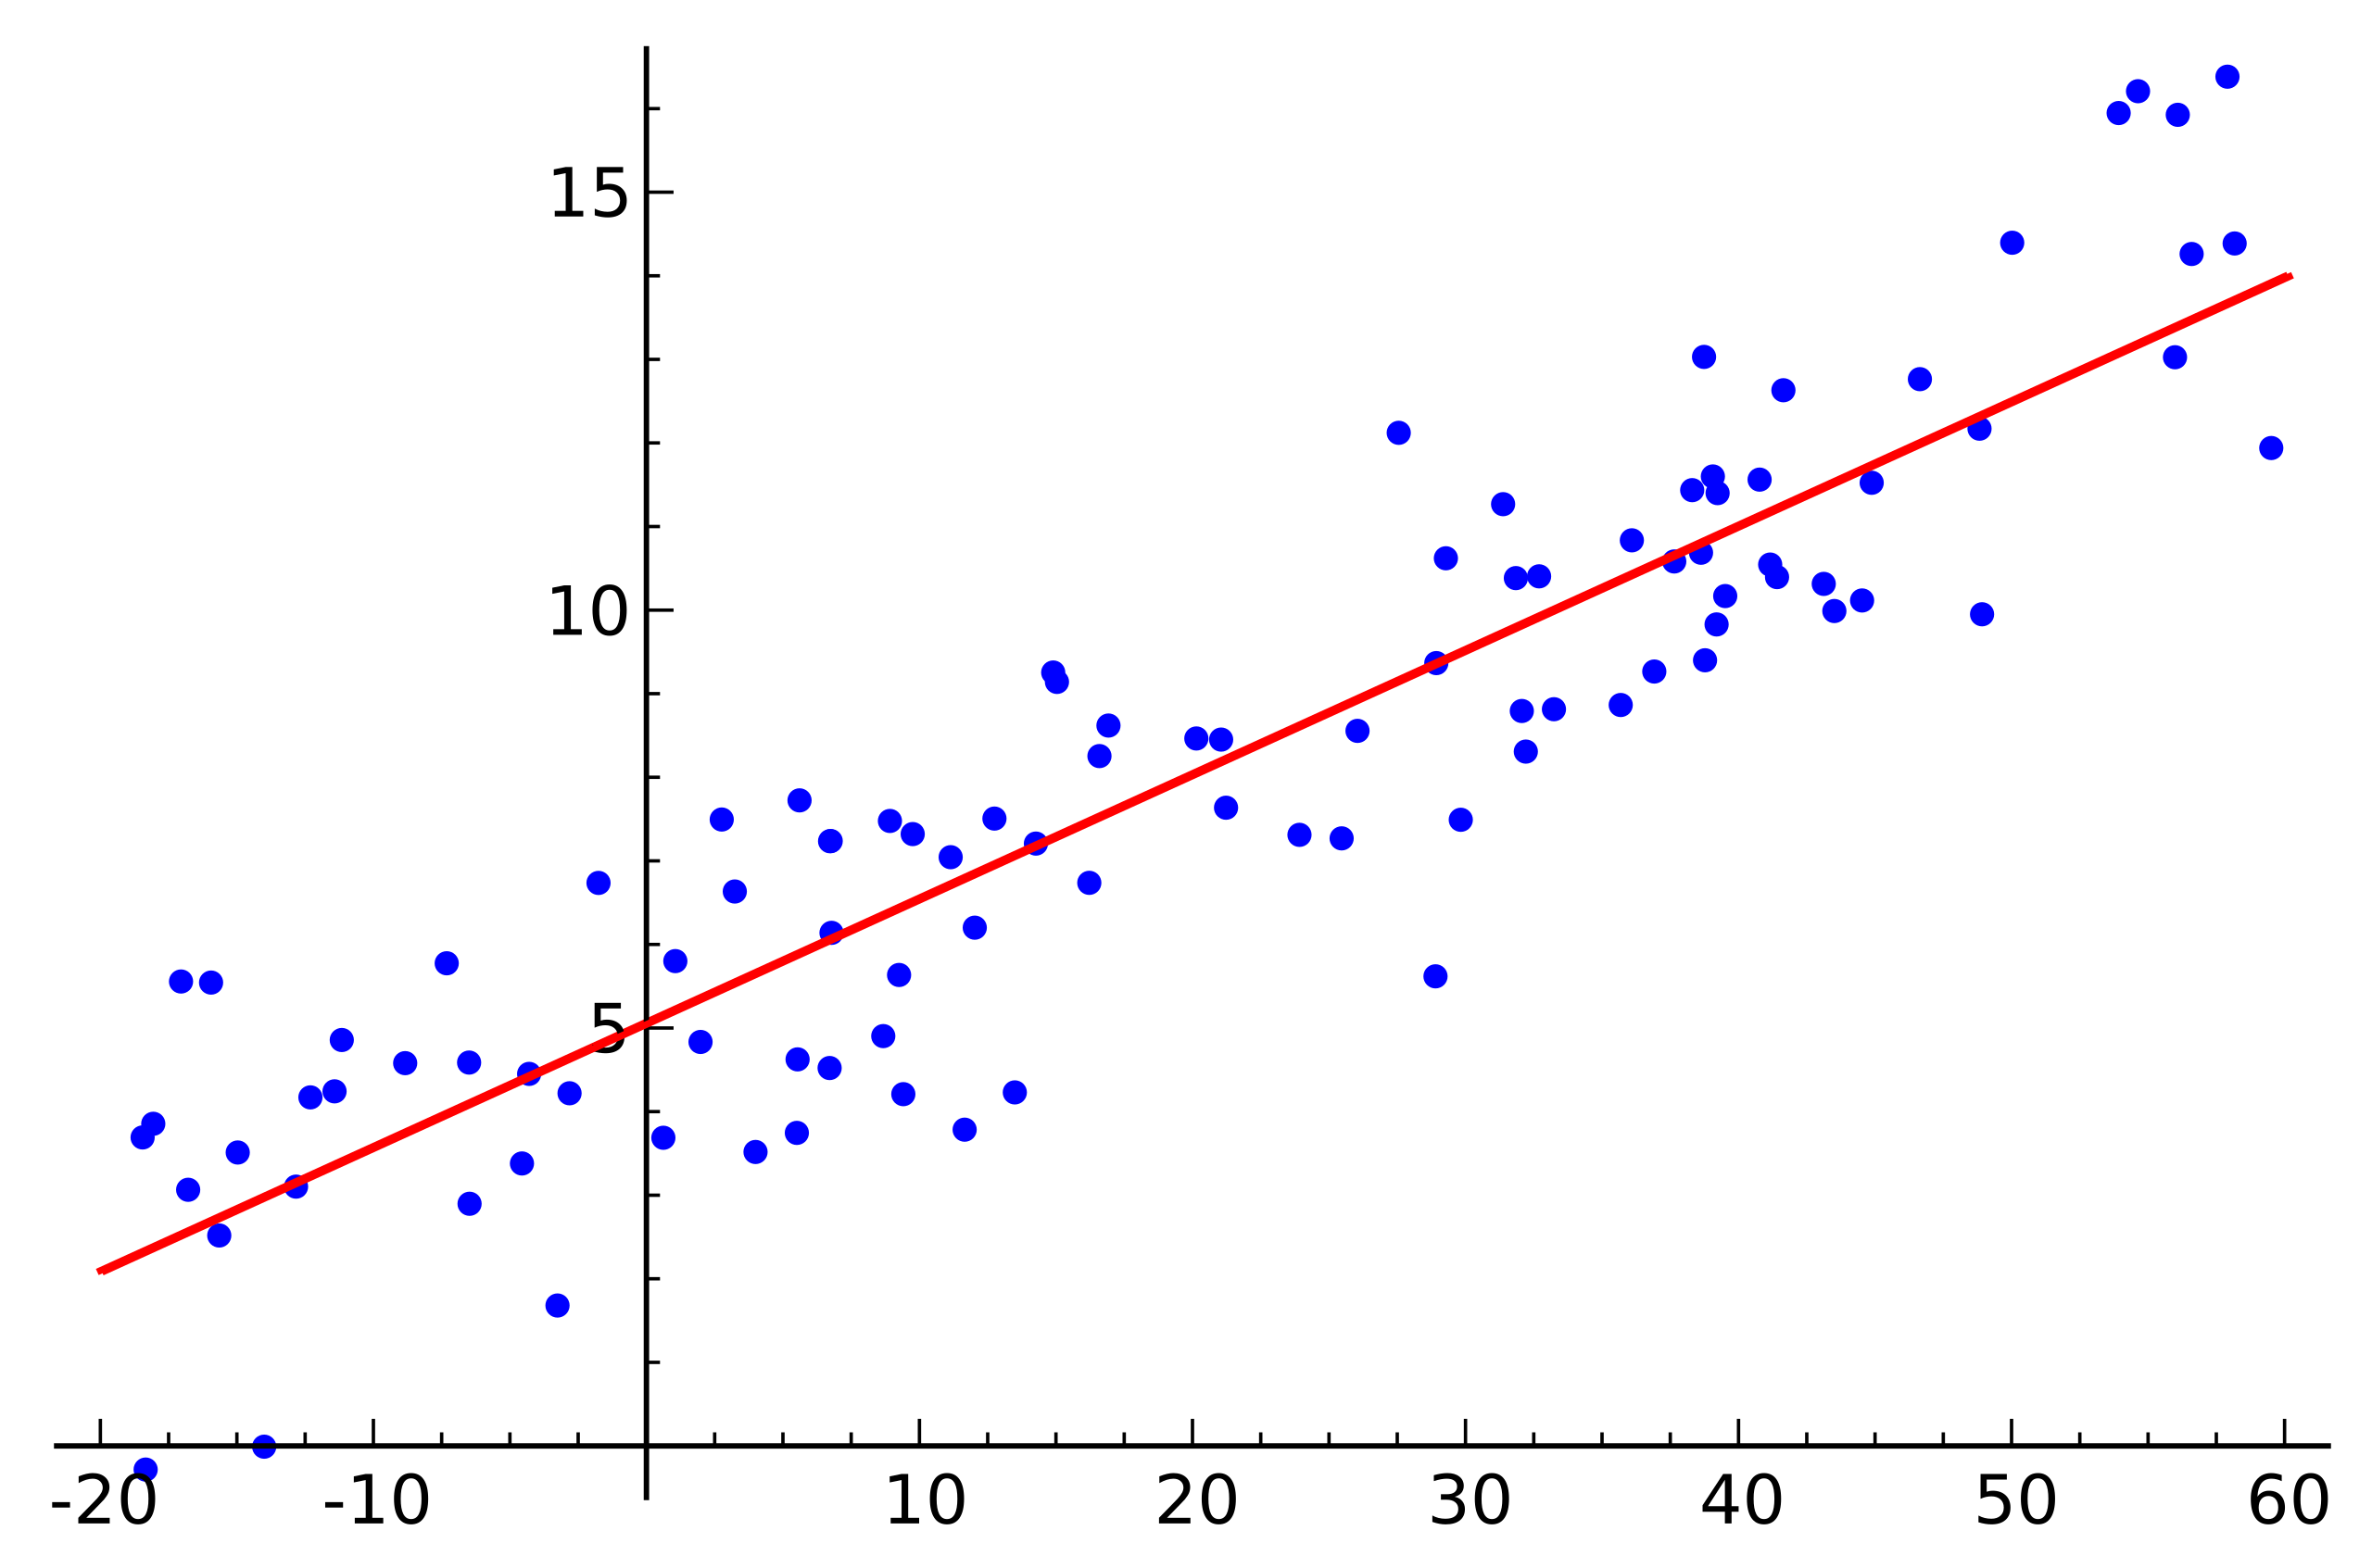
Approach
Models
Logistic regression
Random Forest
Support Vector Machine
SMOTE
Something
Else
here

Slide 15
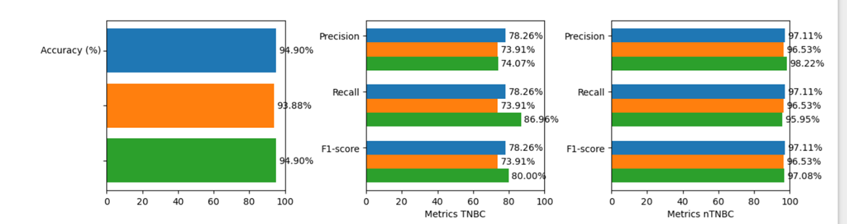
Train / Test
Research Papers
Results
Statistical
Validation
Research Papers
Statistical

Slide 16
Discussion
Findings / conclusion

Slide 17
Thank you for your attention
Ruben Holthuijsen (1064459) • Sander van Swieten (1063788) • Vince van Doorn (1061669)
Victor de Sousa Gama (0929470) • Kevin Hartman (1044032)

